Slide 1

Artificial Intelligence
Lecture 1
By/ aly maher abdelfattah

Slide 2
Why Study AI?
AI makes computers more useful.
Intelligent computer would have huge impact on civilization.
AI cited as “field I would most like to be in” by scientists in all fields
Computer is a good metaphor for talking and thinking about intelligence.

Slide 3
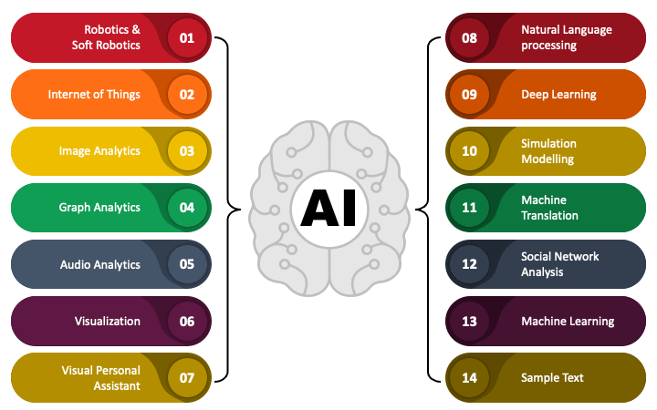
Applications of AI

Slide 4
What is the definition of AI?
Intelligence can be defined in many ways, from the ability to learn to deal with new situations to the ability to make the right decisions according to some criterion.
Many tasks that come naturally to humans —such as perception and control tasks—are extremely difficult to write formal rules or programs for a machine to execute.
Often it is hard to codify all the knowledge and thought processes behind information processing and decision making into a formal program on which a machine can then act.

Slide 5
What is the definition of AI?
Humans, on the other hand, over their lifetime can gather a large amounts of data through observation and experience that enables this human level of intelligence, abstract thinking, and decision making.
Artificial intelligence (AI) is a broad field of study the complex problem and the human-like ability to sense, act, and reason.
One goal of AI can be to create smart machines that think and act like humans, with the ability to simulate intelligence and produce.
Artificial intelligence (AI) is a field of computer science that looks at the logic behind human intelligence. The field seeks ways to understand how we think and to re-create this intelligence in machines. Because of its nature, AI extends across human activities, making it relevant in different ways to every industry.

Slide 6
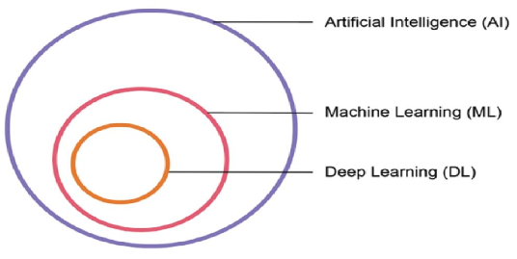
Machine Learning
Machine learning makes up a large portion of artificial intelligence being applied in businesses today.
The goals of machine learning are to automate processes in order to decrease human effort, and to discover complex patterns that humans cannot interpret on their own.

Slide 7

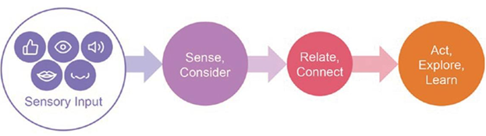
What Is Learning?
If we could simplify human learning, we might say that humans take information from their environment, relate it to something, and then learn or act.
These inputs could be something they see, taste, hear, feel, or even their interpretation of a mood or tone.
• That information is related to prior knowledge a person has about the world, making a connection.
• From there, a human might act on their new knowledge, explore, or innovate.
How machines learn
How humans learn

Slide 8
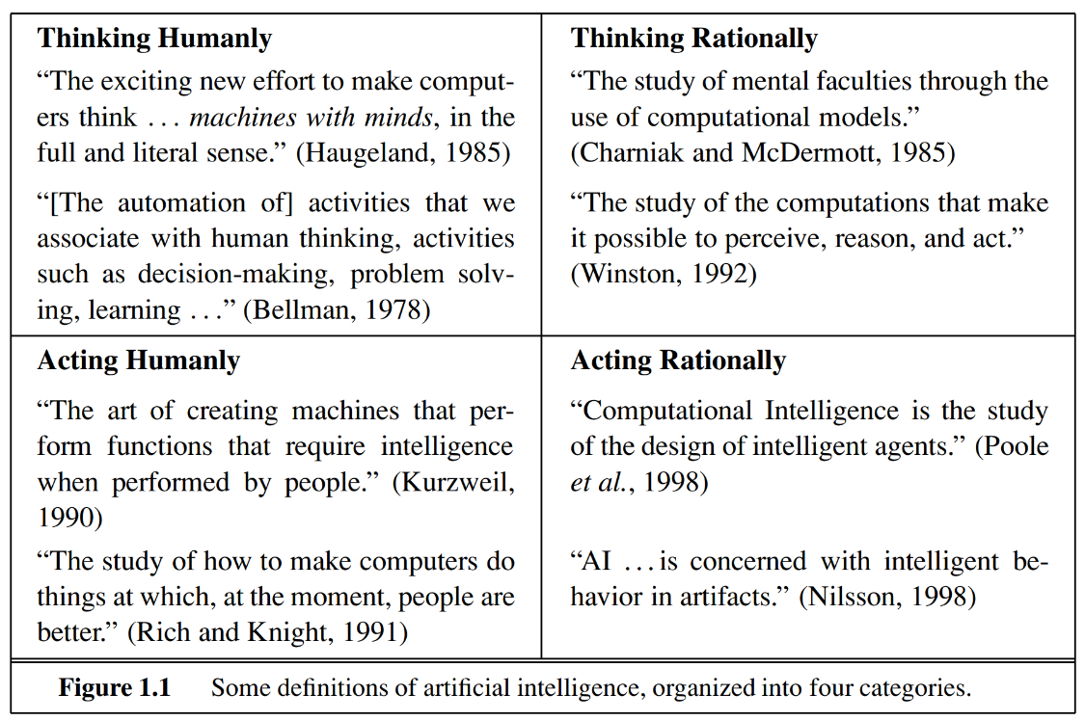
What is the definition of AI?

Slide 9
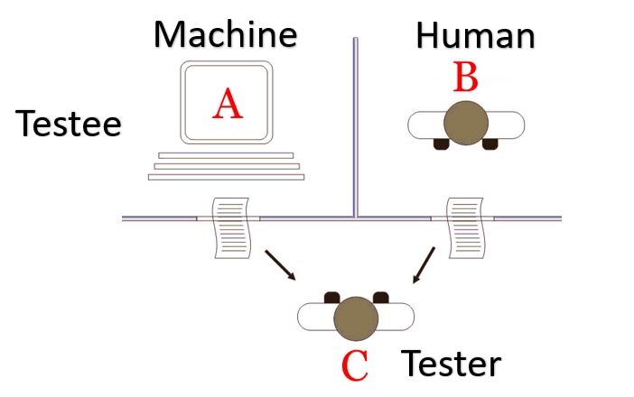
Acting humanly: The Turing Test approach
The Turing Test, was designed to provide a satisfactory operational definition of intelligence. A computer passes the test if a human interrogator, after posing some written questions, cannot tell whether the written responses come from a person or from a computer.

Slide 10
Acting humanly: The Turing Test approach
The computer would need to possess the following capabilities:
• natural language processing to enable it to communicate successfully in English
• knowledge representation to store what it knows or hears
• automated reasoning to use the stored information to answer questions and to draw new conclusions
• machine learning to adapt to new circumstances and to detect and extrapolate patterns.
• computer vision to perceive objects, and
• robotics to manipulate objects and move about.

Slide 11
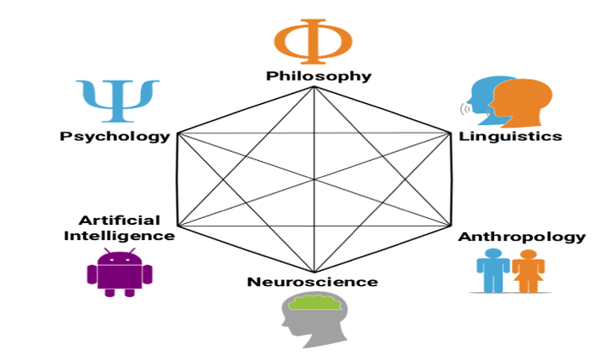
Thinking Humanly: The cognitive modeling approach
Requires knowledge of brain function
What level of abstraction?
How can we validate this
This is the focus of Cognitive Science
Cognitive science, the interdisciplinary scientific investigation of the mind and intelligence. It encompasses the ideas and methods of psychology, linguistics, philosophy, computer science, artificial intelligence (AI), neuroscience (see neurology), and anthropology

Slide 12
Thinking rationally: The “laws of thought” approach
What are correct arguments or thought processes?
Provided foundation of much of AI.
Not all intelligent behavior controlled by logic
What is our goal? What is the purpose of thinking?
These laws of thought were supposed to govern the operation of the mind; their study initiated the field called logic.
The logic within artificial intelligence hopes to build on programs to create intelligent systems.
Logic as conventionally understood requires knowledge of the world that is certain.
The theory of probability fills this gap (certain), allowing accurate reasoning with uncertain information

Slide 13
Acting rationally: The rational agent approach
An agent is just something that acts
• Computer programs do something, but computer agents are expected to do more: operate autonomously, perceive their environment, persist over a prolonged time period, adapt to change, and create and pursue goals.
A rational agent is one that acts so as to achieve the best outcome or, when there is uncertainty, the best expected outcome.
Making correct inferences is sometimes part of being a rational agent,
• Because one way to act rationally is to deduce that a given action is best and then to act on that conclusion

Slide 14
Acting rationally: The rational agent approach
The rational-agent approach to AI has two advantages over the other approaches.
First, it is more general than the “laws of thought” approach because correct inference is just one of several possible mechanisms for achieving rationality.
Second, it is more amenable to scientific development.
• The standard of rationality is mathematically well defined and completely general. We can often work back from this specification to derive agent designs that provably achieve it.

Slide 15
Components of an AI System
Systems that can reasonably be called intelligent.
We begin by examining agents, environments, and the coupling between them.
The observation that some agents behave better than others leads naturally to the idea of a rational agent.
An agent is anything that can be viewed as perceiving its environment through sensors and acting upon that environment through actuators (effectors).

Slide 16
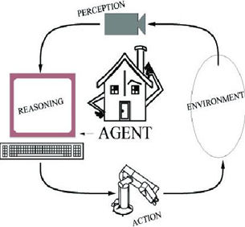
Components of an AI System
An agent perceives its environment through sensors and acts on the environment through effectors.
Human: sensors are eyes, ears, actuators (effectors) are hands, legs, mouth.
Robot: sensors are cameras, sonar, lasers, bump, effectors are grippers, manipulators, motors
The agent’s behavior is described by its function that maps percept to action.

Slide 17
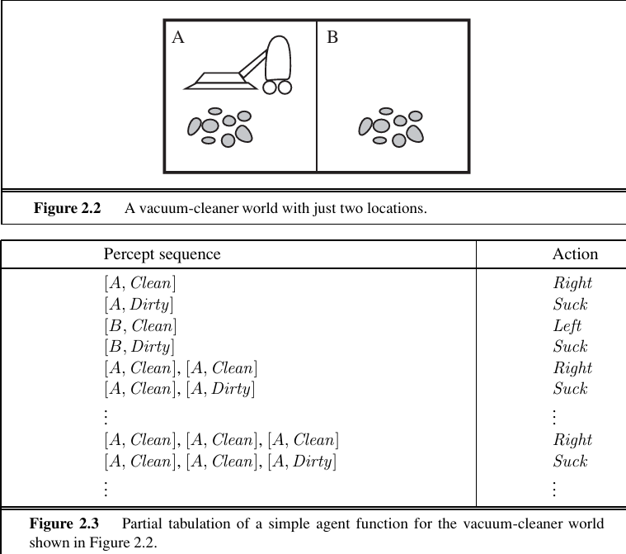
Rationality
A rational agent does the right thing
A fixed performance measure evaluates the sequence of observed action effects on the environment.

Slide 18
PEAS
Use PEAS to describe task
• Performance measure
• Environment
• Actuators
• Sensors
The agent’s prior knowledge of the environment.
The actions that the agent can perform.
The agent’s percept sequence to date.
A rational agent should select an action that is expected to maximize its performance measure

Slide 19
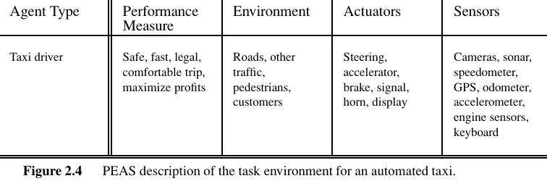
PEAS
Use PEAS to describe task
• Performance measure
• Environment
• Actuators
• Sensors
The agent’s prior knowledge of the environment.
The actions that the agent can perform.
The agent’s percept sequence to date.
A rational agent should select an action that is expected to maximize its performance measure

Slide 20
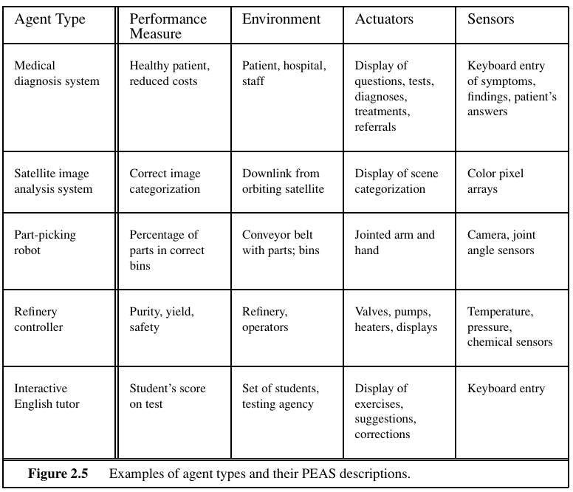
PEAS

Slide 21

Thank you

